Slide 1
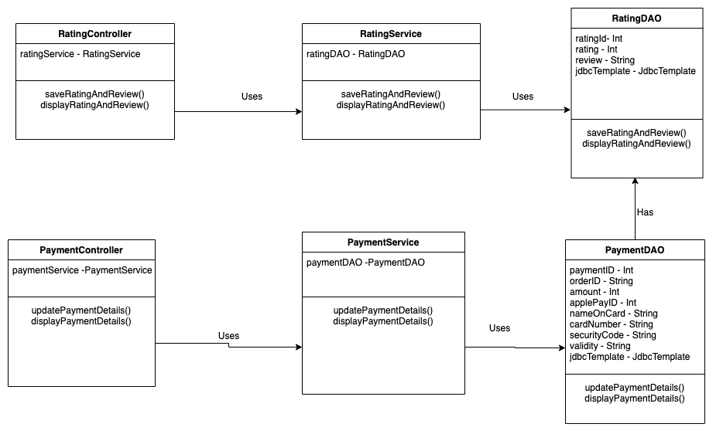
Class Diagram – Food Express
04.09 Add Rating/review and 03.02 Updtae payment details

Slide 2

Sequence Diagram – Food Express
Use Case - 04.09 Add Rating/review
User
:RatingController
:RatingService
:RatingDAO
Use Case Scenario
This Use case begins when the Customer gives Rating and Review for an order.
System saves the details of the Rating and Review into the database.
Sytem displayed the Rating and Review details once user views existing order.
The Use Case ends.
saveRatingAndReview()
saveRatingAndReview()
saveRatingAndReview()
displayRatingAndReview()
displayRatingAndReview()
displayRatingAndReview()

Slide 3
Sequence Diagram – Food Express
Use Case - 03.02 Updtae payment details
User
:PaymentController
:PaymentService
:PaymentDAO
Use Case Scenario
This Use case begins when the Customer update the payment details.
System saves the updated payment details into the Database and displays the payment details during the order placement.
The Use Case ends.
updatePaymentDetails()
updatePaymentDetails()
updatePaymentDetails()
displayPaymentDetails()
displayPaymentDetails()
displayPaymentDetails()

